Slide 1
Notes:
Src: http://pkkindia.blogspot.com/2011/02/computer-vision-syndrome.html

Slide 6
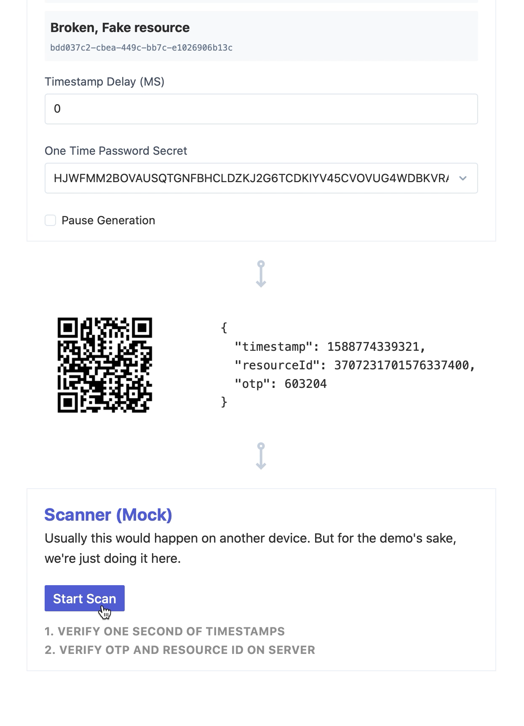
https://dino-demo.now.sh

Slide 8
s

